Slide 1
Data analytics for Cyber security
-Introduction to Data Mining-
Vandana P. Janeja
©2022 Janeja. All rights reserved.

Slide 2
Outline
Knowledge Discovery and Data Mining Process Models
Data Preprocessing
Data Cleaning
Data Transformation and Integration
Data Reduction
Data Mining
Measures of Similarity
Measures of Evaluation
Clustering Algorithms
Classification
Pattern Mining: Association Rule Mining

Slide 3
Data Mining
Discovery of hidden and nontrivial patterns
In very large datasets
But could also be smaller datasets with large number of features
The discovered patterns are potentially actionable and beneficial to study the problem at hand

Slide 4
Data Mining
Goals of Knowledge Discovery include the discovery of new patterns or verifying a hypothesis that the users generally accept or are interested in evaluating, such as prediction of future events or explanation to the user in the form if understandable and intuitive knowledge discovered
Increasingly, as data are becoming very large, data mining fits into the core analytics of any big data solution
The core functionality of the mining algorithms does not change drastically; however, the infrastructure managing the parallelization is a key distinguishing factor in a big data environment.

Slide 5
Goals of Knowledge Discovery and components of Data Mining methods
Goals of Knowledge Discovery
Discover New Patterns
Prediction
Description /presentation to User
Verify User Hypothesis
Data Mining Methods
Model Representation
Model evaluation
Search

Slide 6
Data Mining method Components
The model being used and its representation
This refers to the language used to describe the patterns along with any representational assumptions
A method to evaluate the model
DM algorithms have an expected output, and quality of results based on this can be quantified through an evaluation metric (such as accuracy and error metrics)
A search component
This involves a parameter search and model search.
This component allows for finding the optimal fit of both the model and parameter to use based on maximizing the evaluation criteria

Slide 7
DM method example evaluation criteria
DM Method | Example Evaluation criteria
Classification | Accuracy, Precision, Recall, F-Measure
Clustering | Sum of Squared Error, Silhouette Coefficient
Association rule mining | Confidence, Support, Lift

Slide 8


Steps for a standard knowledge discovery process
Heterogeneous Data Sources
Data Integration and Selection
Data Preprocessing
Data Mining
Pattern Evaluation
Actionable Knowledge
Notes:
The process starts with large and potentially heterogeneous data sources. Through user input, data need to be identified and selected based on the task being addressed. As discussed in some models (such as Cross Industry Standard Process for DM [CRISP-DM]; see Shearer 2000 and Chapman et. al. 2000 ), it is important to have user input at this stage to clearly understand the business or user requirements that can facilitate better and more targeted data selection. Once the right data sources are identified, integrated data preprocessing is performed on these data sources. Data preprocessing tasks can include filling missing values, semantic mapping, removing redundancy in the data through correlation, noise removal, smoothing of the data, data volume reduction, and feature selection, among others. A large amount of preprocessing can done while integrating the data to resolve data inconsistencies. Data preprocessing generally takes up a majority of time, up to 80%, in any data mining project. A good preprocessing leads to good data mining. Data that have not been sufficiently preprocessed may lead to frivolous and random results. Thus, sufficient time should be allocated to the preprocessing tasks.
Once the data have been processed, then the relevant data mining task can be applied. Then the results need to be evaluated, and once this evaluation is quantified any patterns found can become actionable knowledge. It is clearly possible that any stage can send the process back to any of the preceding steps. In addition, once actionable patterns have been tested or examined by the end users, changes can be made to how and what data are collected for better knowledge discovery

Slide 9
Data Preprocessing
Data in the real world tend to be messy
Caused by device malfunction
Data entry errors
Or by data integration from heterogeneous sources.

Slide 10
Data Preprocessing
To get high-quality mining results that are actionable and beneficial, it is important to clean up the messy data
Data can be very large in terms of size and number of attributes, meaning that important patterns get hidden in the subspaces
It is important to focus on the right portions of the data both in terms of the volume and the attributes
Data preprocessing such as data cleaning, data transformation, and data reduction, as well as careful data integration, prepares the data for mining
These tasks will vary based on the data types and the complexity of the data

Slide 11
Data Types
Text
Numeric (discrete or continuous)
Ordinal (order or ranked data, such as severity scores, which have an inherent order to them)
Binary data (with only two possible outcomes)
Categorical data (with multiple categories).
Complex datasets may consists of multiple types of attributes in them
Notes:
Complex datasets may consists of multiple types of attributes in them; for example, intrusion log data will consist of text, categorical, and numeric data attributes

Slide 12
Examples Data Types
Attribute Data Type | Example
Numeric | Number of bytes sent
Categorical | Type of attack
Binary | Presence or absence of virus
Ordinal | Severity of alert( Low medium high)
Text | Intrusion alarm text
Complex Types of Datasets | Example
Unstructured Text | Spam email Intrusion log data
Spatial Data | Geographical Server locations Locations of Cyber physical sensors Locations of spam origination
Graph data | IP communication graph Routing paths for communication
Data Analytics for Cybersecurity, ©2022 Janeja All rights reserved.

Slide 13

Data Preprocessing
The preprocessing tasks to apply are selected based on the complexity of the data and the attribute types
For example:
  Similarity in the data is defined differently for numeric attributes versus binary valued attributes
  For complexity of the data, for example, spatial data, would require additional steps such as discovering spatial proximity, such that the mining task can be separated by spatial neighborhoods

Slide 14
Data Cleaning
Missing data values
Fluctuations in the data
Inconsistencies and redundancies in the data
Notes:
Many times in network traffic data we might see missing data values due to dropped packets, traffic fluctuations over different time periods, and generally redundancies in network communication data. This step addresses the general cleanup of messy data, including (a) missing data values, (b) fluctuations in the data, and (c) inconsistencies and redundancies in the data.

Slide 15
Data Cleaning
Missing Data
Replace by mean of the attribute if numerical or mode if categorical
If the dataset is large or has multiple classes/groups - use the mean of the group to replace the missing values in that particular group
Predict the missing values by training based on the records that have the complete data.
Replace if roughly less than 5% of the data are missing; Consult with a domain expert or utilize domain heuristics to decide if data should be discarded or filled in to impute the missing data.
Noisy data
Clean the noise by smoothing out the data to provide simpler and more refined representations
Divide data into small groups, the mean behavior of the groups can be used to represent all the data in the group
Small groups can be created by creating small bins or buckets in the data, and the mean or mode of the data can replace all the values in each bin.
Binning - an unsupervised splitting-based discretization method of the data
Equal frequency binning roughly deposits an equal number of points are across a fixed number of bins
Equal distance binning distributes an equal distance across a fixed number of bins
Clustering where similar data points are grouped together and the mean or centroid of the cluster can be used to replace the other values can also create a smooth dataset.
Outliers
Decide beforehand through discussions with end users whether outliers need to be accommodated or eliminated
Also determined by the types of patterns being discovered (for example: to find anomalies, outliers might be kept in the data)
If the mining task is finding the normal behavior, such as the baseline network signatures, then consider removing outliers
For univariate data, several statistical methods such as interquartile range (IQR)–based outlier detection, discordancy tests, and standard deviation–based tests can be used.
For multivariate data, distance-based outlier detection methods can be utilized.
Notes:
Many times in network traffic data we might see missing data values due to dropped packets, traffic fluctuations over different time periods, and generally redundancies in network communication data. This step addresses the general cleanup of messy data, including (a) missing data values, (b) fluctuations in the data, and (c) inconsistencies and redundancies in the data.

Slide 16
Data Transformation and Integration
When data are merged from multiple sources, the resolution of the data may be different
  Years rather than days.
  Attribute ranges may vary, and these ranges may be very large
  In these and other scenarios, the data will need to be transformed such that the traditional data mining algorithms can be uniformly applied.
  Other data integration steps such as mapping the structure and content also need to be performed
Normalization : One common data transformation method of normalization is the min–-max normalization or feature scaling
In this method, a new range, for example 0 to –1, is created for the data such that the old min becomes 0 and the old max becomes 1
All the data are transformed within the new range
Allows for a rescaling of the data to a new well-defined range
Other measures such as z-score normalization work well when the data is are normally distributed, and the mean is well defined.

Slide 17
Example Data preprocessing
Data
Equal Frequency binning
Equal Distance binning
Min-Max Normalization
sorted values
5
Equal Freq Binning
Equal
7
5
distance
Distance in
(c)
Min Max
8
7
bin
Bin
Normaliza
10
Bin 1
8
5
0
Data
tion
11
10
7
2
5
0
24
11
Bin 1
8
3
7
0.046512
25
24
10
5
8
0.069767
25
11
6
10
0.116279
27
25
24
0
11
0.139535
27.95
25
25
1
24
0.44186
28
27
25
1
25
0.465116
28
27.95
27
3
25
0.465116
29
Bin2
28
27.95
3.95
27
0.511628
29
28
Bin2
28
4
27.95
0.533721
33
29
28
4
28
0.534884
38
29
5
28
0.534884
29
29
5
29
0.55814
38
33
29
0.55814
39
38
33
9
33
0.651163
41
38
14
38
0.767442
(a)
47
38
38
14
38
0.767442
47
Bin 3
39
39
0
39
0.790698
48
41
41
2
41
0.837209
Sorted Data with mean replacement
47
Bin 3
47
8
47
0.976744
47
47
8
47
0.976744
48
48
9
48
1
(b)
min
5
0
max
48
1
For num bins B=3,
num obs=22
  Bin Width=22/3=7
  Last BW=7+1
For num bins B=3, max=48, min=5
Distance Threshold=
(48-5)/3=14.33

Slide 18
Data Reduction
Patterns in very large amounts of data- For example, network traffic data from Wireshark can become terabytes of data even within a few seconds; Similarly, source and destination-based communication graph can be a massive dataset. In such cases data reduction is an important strategy to help reduce the volume and attribute set of the data.
Reducing dimensions - For example, in the Wireshark data capture, we might mainly be interested in looking at just the source and destination to generate a communication graph and annotate the graph with packet size.
Sparse datasets - data reduction helps identify the key subspaces of the data
Volume reduction- For example, smoothing techniques, central measures of the smoothed data can be used instead of all the data points.
Feature selection - to identify the relevant features for performing data mining
  Ranking-based methods that use entropy measures to quantify how much data are useful in each of the attributes.
  Singular-value decomposition and principal component analysis work on the common principal to transform the data such that a combination of the features can be used as transformed features.

Slide 19
Data Mining Methods
Clustering
– e.g. Kmeans, Kmodes, Density based clustering
Unsupervised method
Identifying grouped anomalies
Identifying individual point outliers or cluster outliers
Classification
– e.g. decision tree based algorithms, Support Vectors, Ensemble methods
Supervised Method
Identifying classes of attacks
Anomaly detection using ensemble methods
Zero day attack detection
Association rule mining
– e.g. apriori, efficient association discovery (FP Tree)
Discovering Communication patterns
Models of anomalous communication patterns
Anomaly Detection
Data Analytics for Cybersecurity, ©2022 Janeja All rights reserved.

Slide 20
Data Mining
Data in security applications are heterogeneous, high-dimensional, and often complex.
Three key groups of methods, namely clustering, classification, and association rule mining.
The supervised methods are also referred to as machine learning, where historic data help train the algorithm to make predictions.
Each of these methods also feeds into the discovery of anomalies or unusual patterns, which is particularly relevant to cybersecurity.
Anomaly detection deals with finding individual objects and rare combinations of objects that are unusual (anomalous) with respect to other “normal” data points.
Often the normal is a cluster or a set of clusters and the anomalies are the outlier data points.

Slide 21
Preliminaries to Data Mining
Measures of similarity: useful to find what is similar enough for creating clusters
Distance Measures
Similarity in Binary valued variables
Measures of evaluation: Various metrics that are used to evaluate the multiple data mining approaches
Accuracy
Precision
Recall
F-measure
Lift
Confidence

Slide 22
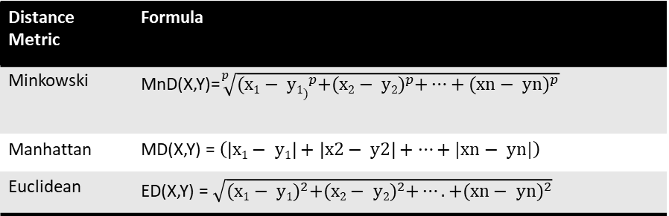
Example distance metrics
Primarily used in clustering
A non-negative function d(x,y), measuring distance between objects x and y, is a metric if it satisfies:
  the identity property, d(x,x) = 0,
  the symmetry property, d(x,y) = d(y,x), and
  the triangle inequality, g(x,y) + g(y,z)≥g(x,z)
Distance Metric | Formula
Minkowski | MnD(X,Y)=$\sqrt[p]{{(x1− y1)}^{p}+{(x2− y2)}^{p}+…+{(xn− yn)}^{p}}$
Manhattan | MD(X,Y) = $\left(\left|x1− y1\right|+\left|x2− y2\right|+…+|xn− yn|\right)$
Euclidean | ED(X,Y) = $\sqrt{{(x1− y1)}^{2}+{(x2− y2)}^{2}+….+{(xn− yn)}^{2}}$

Slide 23
Similarity in Binary valued variables
O1 | 1 | 1 | 0 | 0
O2 | 1 | 1 | 1 | 0
O3 | 0 | 0 | 0 | 1
Similarity coefficient matrix for binary valued attributes as illustrated
Start with the data matrix comprising of feature vectors for each object
The data matrix is thus an n ×m matrix consisting of n objects each with a feature vector of m features.
The first step is to determine the contingency matrix using this data matrix which essentially is the values of a, b, c, and d for each data object pair.
  a equals the number of positive matches such that objects oi and oj both have a value of 1,
  b equals the number of mismatches such that oi has a value of 1 and oj has a value of 0,
  c equals the number of mismatches such that oi has a value of 0 and oj has a value of 1, and
  d equals the number of negative matches such that oi and oj both have a value of 0.
Once these values are computed, they can be used to compute the similarity using different types of similarity coefficients such as Jaccard Coefficient (a/a+b+c). The output is a n × n triangular matrix with the computed similarity between each object pair
Data Matrix
Contingency Matrix
 | a (1-1) | b (1-0) | c (0-1) | d (0-0)
S(O1,O2) | 2 | 0 | 1 | 1
S(O1,O3) | 0 | 1 | 1 | 2
S(O2,O3) | 0 | 3 | 1 | 0
Similarity Matrix (Jaccard Coefficient)
 | O1 | O2 | O3
O1 | 1 | 0.5 | 0
O2 |  | 1 | 0
O3 |  |  | 1

Slide 24
Types of Similarity Coefficients
The coefficients can be divided into Asymmetric and Symmetric.
Asymmetric coefficients ignore negative matches (d), and should therefore be applied to data where absences (0s) are thought to carry no information.
  An example is Jaccard’s Coefficient.
  For example if we would like to study attacks then a system which did not have a set of attacks is not a relevant question so features with a 0-0 match (i.e. not had an attack) is not relevant.
Symmetric coefficients acknowledge negative matches, and should therefore be applied to data where absences are thought to carry information.
  An example is the Simple Matching Coefficient.
  For example if we are studying impact of a vulnerability patch on a software then if in two types of applications there was no impact of the patch then this is pertinent information we want to capture.
There are some other types of coefficients called as hybrid which include the 0-0 match in either the numerator or denominator but not both.

Slide 25
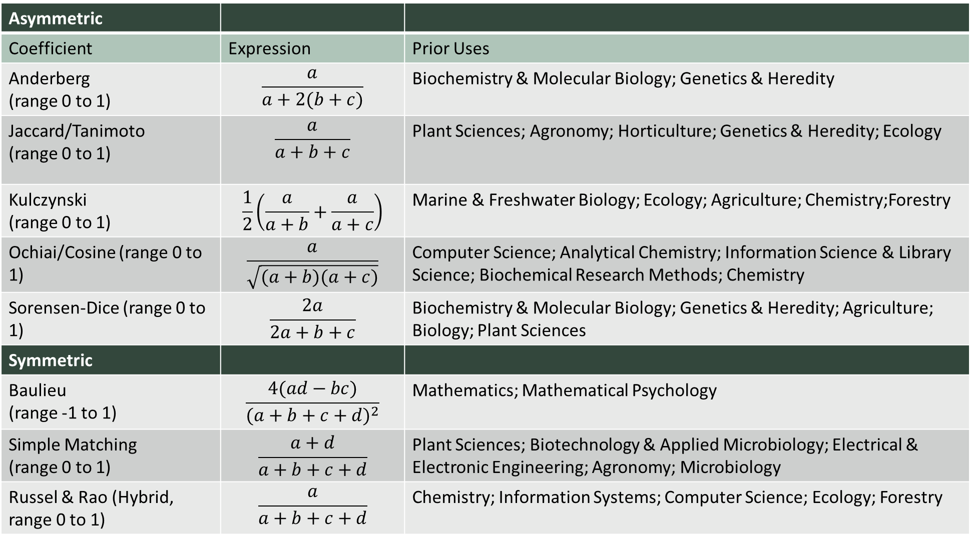
Types of Similarity Coefficients
Asymmetric
Coefficient | Expression | Prior Uses
Anderberg (range 0 to 1) | $$\frac{a}{a+2(b+c)}$$ | Biochemistry & Molecular Biology; Genetics & Heredity
Jaccard/Tanimoto (range 0 to 1) | $$\frac{a}{a+b+c}$$ | Plant Sciences; Agronomy; Horticulture; Genetics & Heredity; Ecology
Kulczynski (range 0 to 1) | $$\frac{1}{2}\left(\frac{a}{a+b}+\frac{a}{a+c}\right)$$ | Marine & Freshwater Biology; Ecology; Agriculture; Chemistry;Forestry
Ochiai/Cosine (range 0 to 1) | $$\frac{a}{\sqrt{(a+b)(a+c)}}$$ | Computer Science; Analytical Chemistry; Information Science & Library Science; Biochemical Research Methods; Chemistry
Sorensen-Dice (range 0 to 1) | $$\frac{2a}{2a+b+c}$$ | Biochemistry & Molecular Biology; Genetics & Heredity; Agriculture; Biology; Plant Sciences
Symmetric
Baulieu (range -1 to 1) | $$\frac{4(ad−bc)}{{(a+b+c+d)}^{2}}$$ | Mathematics; Mathematical Psychology
Simple Matching (range 0 to 1) | $$\frac{a+d}{a+b+c+d}$$ | Plant Sciences; Biotechnology & Applied Microbiology; Electrical & Electronic Engineering; Agronomy; Microbiology
Russel & Rao (Hybrid, range 0 to 1) | $$\frac{a}{a+b+c+d}$$ | Chemistry; Information Systems; Computer Science; Ecology; Forestry

Slide 26
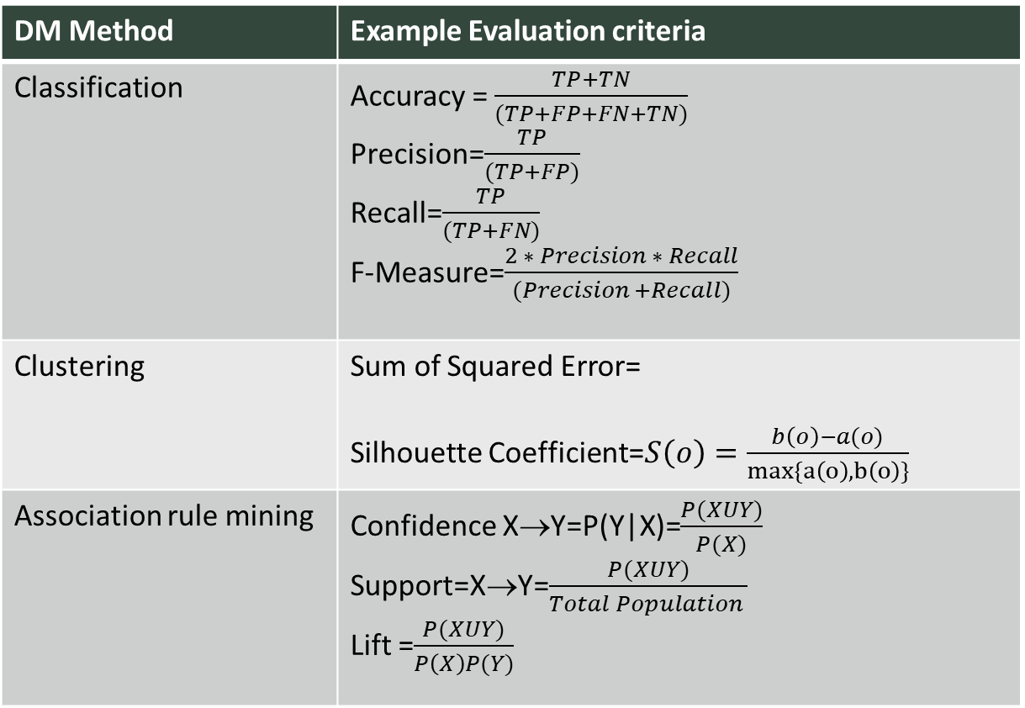
Evaluation Criteria
DM Method | Example Evaluation criteria
Classification | Accuracy = $\frac{TP+TN}{(TP+FP+FN+TN)}$ Precision=$\frac{TP}{(TP+FP)}$ Recall=$\frac{TP}{(TP+FN)}$ F-Measure=$\frac{2 ∗ Precision ∗ Recall}{(Precision +Recall)}$
Clustering | Sum of Squared Error= Silhouette Coefficient=$S\left(o\right)=\frac{b\left(o\right)−a(o)}{max\{a\left(o\right), b\left(o\right)\}}$
Association rule mining | Confidence X→Y=P(Y|X)=$\frac{P(XUY)}{P(X)}$ Support=X→Y=$\frac{P(XUY)}{Total Population }$ Lift =$\frac{P(XUY)}{P\left(X\right)P(Y)}$
Every data mining method needs to have a way to evaluate the results.
The algorithms have a certain expected output,
Evaluation measures help ensure the quality of results from an algorithmic perspective.
Additional quality measures such as usefulness, ground truth evaluation and business evaluation also need to be done.

