Slide 1
Data analytics for Cyber security -Anomaly Detection-
Vandana P. Janeja
©2022 Janeja. All rights reserved.

Slide 2
Outline
Anomaly Detection Methods
Statistical Outlier Detection Tests
Density-Based Outlier Detection OPTICS-OF Identifying Local Outliers
Outlier Detection through Clustering
Distance-Based Outlier Detection
IQR-Based Outlier Detection
Data Analytics for Cybersecurity, ©2022 Janeja All rights reserved.

Slide 3
Anomaly Detection
Anomalies or outliers are objects or groups of objects, which are deviant with respect to other normal objects
Anomalous behavior can be caused by extreme values in some dimensions, which could be an inherent rare property of the anomalous objects
In high dimensional data this rarity increases with the increase in the number of dimensions
Data itself becomes sparse in higher dimensions; this will further aggravate the discovery of outliers
Other anomalous situations may be caused due to measurement errors or phenomena which are causing the deviations
Data Analytics for Cybersecurity, ©2022 Janeja All rights reserved.

Slide 4
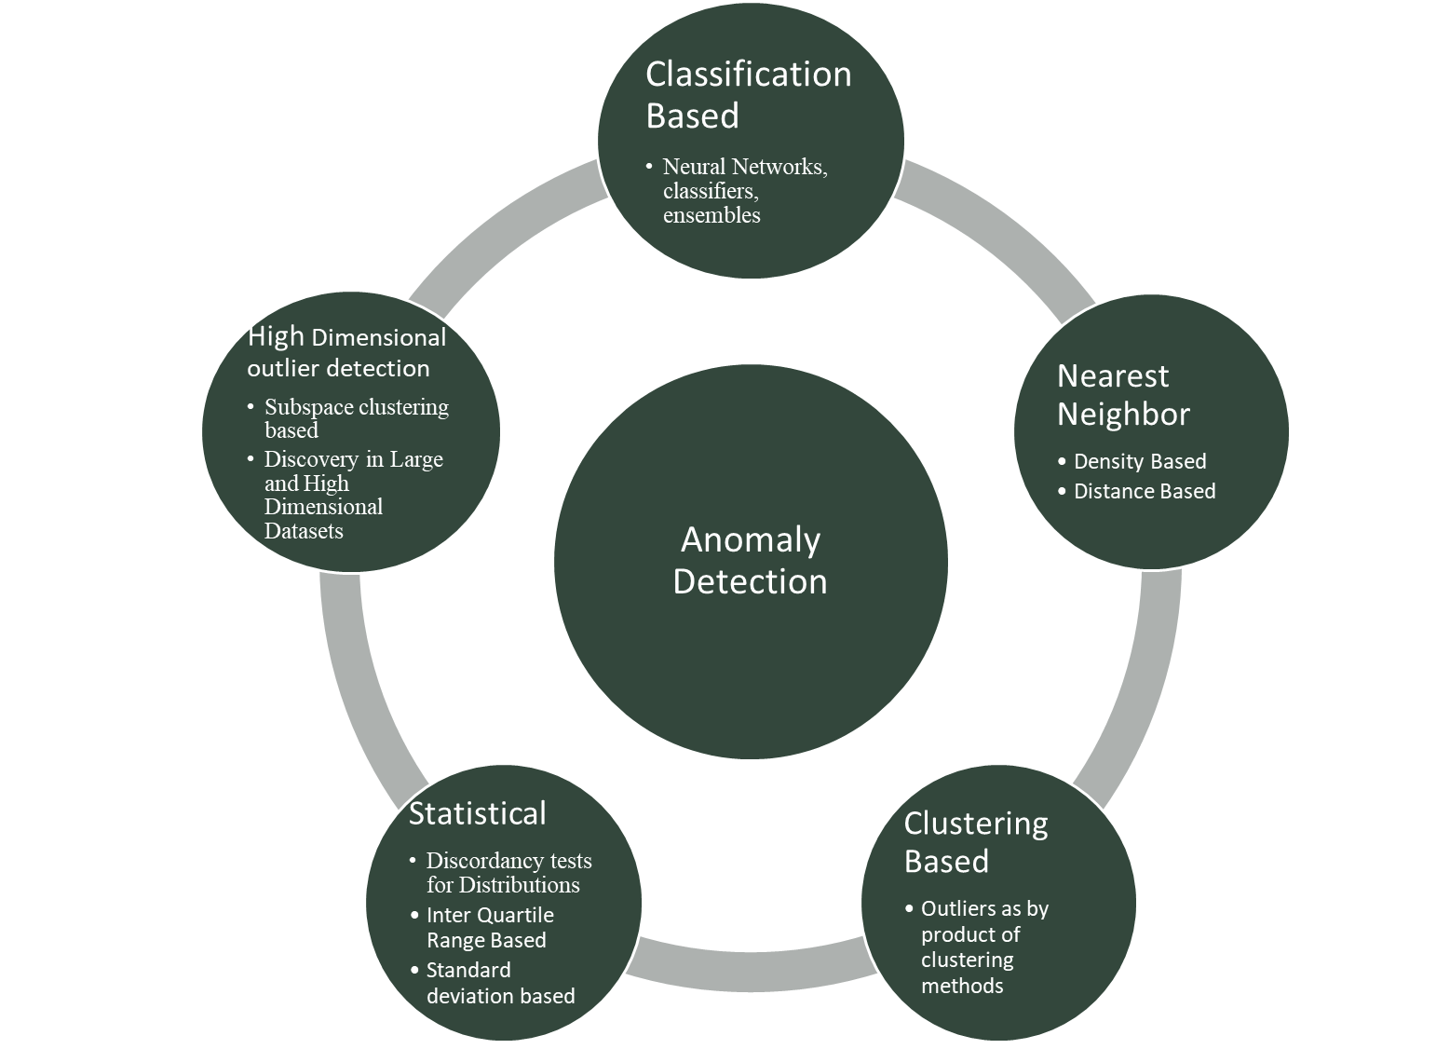
Anomaly Detection Methods
Outlier detection techniques have been adopted from the statistical literature and treat the outliers as parametric outlier detection, in which the data is assumed to fit a certain distribution
The tail region of the distribution, such as in a normal distribution, would constitute the outliers; However, in real world datasets, the data does not fit into a standard statistical distribution
Other techniques detect outliers using metrics such as distance, distance from nearest neighbors, density, deviation and other such measures
By-product of clustering methods: The data is first clustered using some clustering technique and the data points, which lie outside of a cluster, are considered to be outliers.
In some cases part or whole of a cluster of data points could be an outlier based on the problem being studied
Classification based techniques identify and predict anomalies based on historic anomaly signatures
Data Analytics for Cybersecurity, ©2022 Janeja All rights reserved.
Notes:
Figure 7.1 shows a broad categorization of anomaly detection techniques to give an idea of the development in this field. Several recent surveys provide a lot more categories and discuss the works in details (Chandola et. al. 2009, Patcha 2007, Garcia-Teodoro 2009, Bhuyan et. al. 2014).
The discussion in this chapter is limited to key seminal techniques since they are the ground breaking works, which are adopted into different variations in the recent literature such as in the distance based techniques and discovery of anomalies in large, multidimensional data sets.

Slide 5
Statistical Outlier Detection Tests
The distribution based parametric methods are discussed in the statistical outlier detection literature which assume that data fits into a pre specified distribution, such as normal distribution and then identifies the outliers with respect to the model using Discordancy Tests
The discordancy tests are developed based on the properties of the distribution
Discordancy tests assumes a standard distribution of the data set and if the discordancy test finds the outliers then it tries to fit the data to the alternative distribution, however the underlying assumption is that the data fits a distribution, which might not be the case always, especially for multidimensional real world data
If there is a normal distribution where x₁ and x_{n} are the extremes, a discordancy test will check if x_{n} apart from being an extreme is also statistically unreasonable, if it is then it is called a discordant upper outlier
The followup step would be to show that the outlier comes from the alternative distribution and not the working distribution, which is a difficult task in itself
A key metric is to see the fit of the data point using measures such as deviation/spread statistics such that: $d=\frac{μ−x1}{s}$where µ is a measure of central tendency in this case the mean and s can be a known measure of spread such as range
For example, if d <= 1 then x₁ is not an outlier, on the other hand if d >1 it is an outlier
Data Analytics for Cybersecurity, ©2022 Janeja All rights reserved.

Slide 6
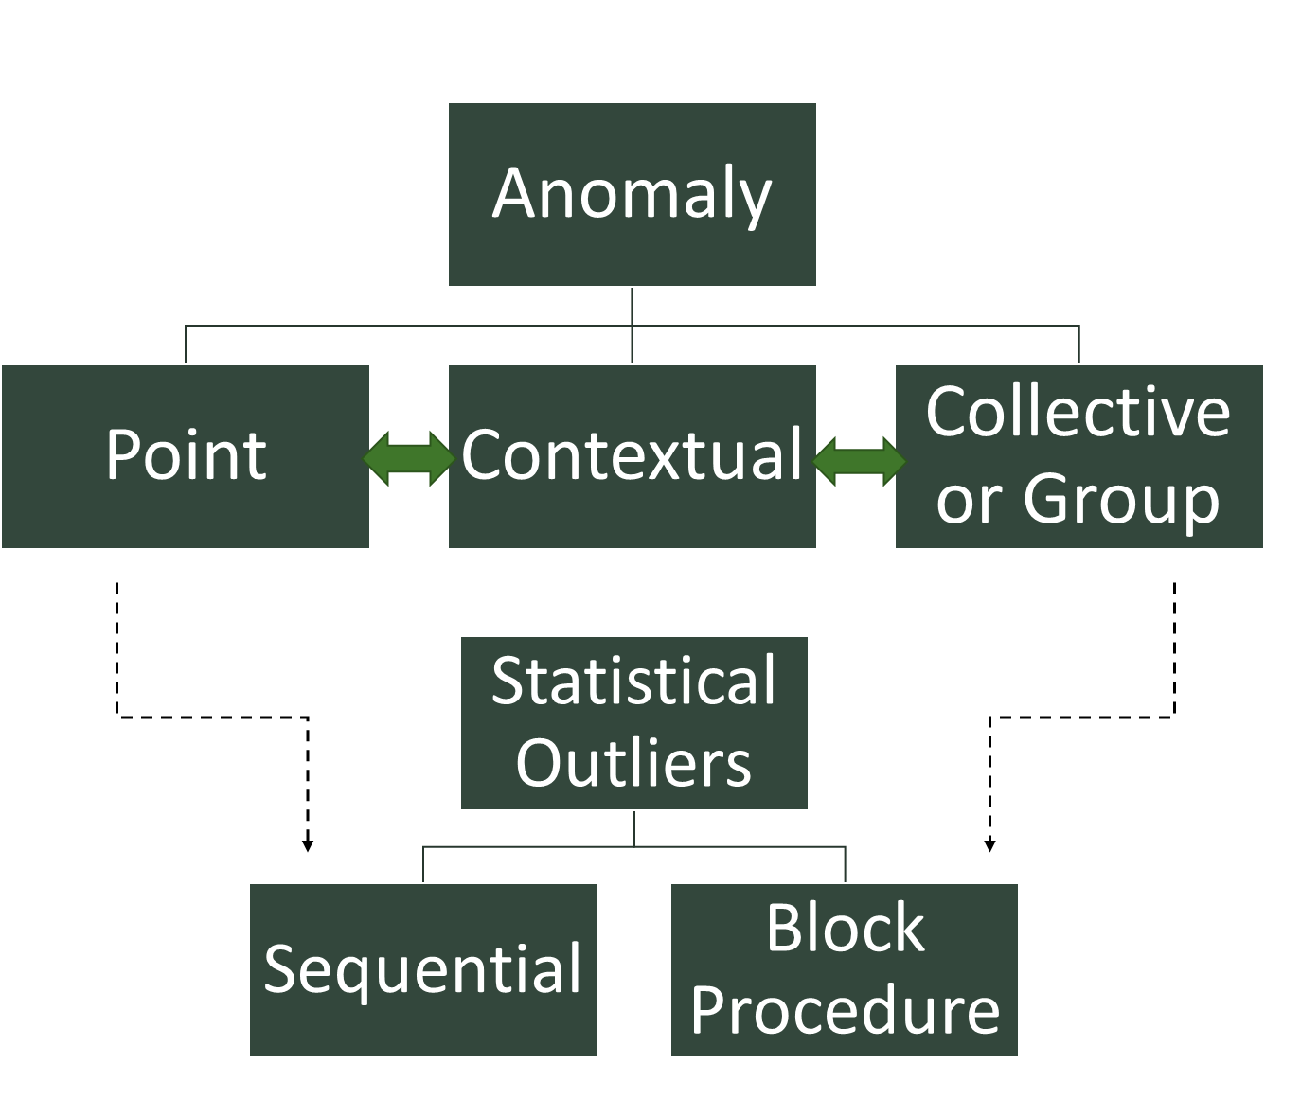
Statistical Outlier Detection Tests
There are two major procedures for outlier detection in statistical studies Block Procedures and Consecutive (Or Sequential) Procedures
Consecutive (Or Sequential) Procedures
sample size is not fixed, but determined in each cycle in relation to the values of earlier observations
Each observation is screened for discordancy in relation to the already screened set of observations
This procedure can be done in two ways: outside inwards which means that the extreme outlier is tested first then second most extreme and so on, but more widely preferred way of doing it is the other way round (starting with the least likely element to be an outlier)
Block Procedures: two or more observations are tested together for outlierness
Consecutive procedures can suffer from challenges such as Masking and Swamping (Barnett and Lewis 1994).
Masking is an erroneous judgment arising out of a single outlier test. Suppose if through a discordancy test for x_{n} it is declared and outlier with respect to all the n-1 values then x_{n-1} is further tested, but if x_{n} is not declared an outlier with respect to all n-1 values then x_{n-1} is not tested
This could be a problem in a scenario where x_{n} is not an outlier with respect to the adjacent value of x_{n-1}, but both x_{n} and x_{n-1} are outliers when tested together with respect to all n-2 values.
Let us consider a small sample values: 8, 10, 11, 13, 1000, and 1005
If tested individually 1009 will not be declared as an outlier since it is close to 1000 but if 1000 and 1005 are tested together against other values then they are outliers with respect to all other n-2 values
Swamping on the other hand results from using a block or consecutive procedure to test for discordancy i.e. testing two values together
For example in a sample: 5,8,10,12,1000
If two values are tested together then they are considered outliers but value 12 is not an outlier, so in essence 12 is swamped by 1000
These procedures have similarity to the point anomaly detection and collective anomaly detection discussed in the data mining literature
This behavior is also seen in majority of outlier detection techniques when the incorrect context for comparison can lead to missing outlier values
Data Analytics for Cybersecurity, ©2022 Janeja All rights reserved.

Slide 7
IQR-Based Outlier Detection
Inter quartile range based outlier detection aims to identify the range of the data and find extreme values which are far away from the range
First, data is sorted in increasing order
The median of the data is identified which becomes the second quartile
All the numbers to the left are smaller than the median and all the numbers to the right are greater
The median of these left and right hand sides are identified as first quartile and third quartile respectively
The data is now divided into four chunks of data ordered by the quartiles
The difference between the third quartile and the first quartile is the Inter Quartile Range (IQR)
IQR based outlier detection assumes that the IQR should have the majority of the data distribution measuring the spread of the data
Now if this IQR range is further stretched beyond the first and third quartile such that the lower threshold is first quartile minus IQR times 1.5 and the upper threshold is third quartile plus the IQR times 1.5
Points which fall beyond these thresholds at the lower extreme or the upper extreme are the outliers
IQR is primarily a univariate outlier detection method
Data Analytics for Cybersecurity, ©2022 Janeja All rights reserved.
Notes:
In general, statistical outlier detection is a highly developed field and has been well established for a long time. However, for outlier detection using statistical methods the distribution of the data set needs to be known in advance and the knowledge of the distribution is the underlying assumption. The properties of the distribution need to be known in advance such as the mean, standard deviation etc. Outlier detection also has to take into consideration the masking and swamping effects for sequential and block procedures. In general the modeling process is more complicated, especially in case of multidimensional datasets. The statistical outlier detection mainly works well for univariate variables. Moreover, these techniques do not work well with incomplete or inconclusive data and computation of the results is expensive.

Slide 8
Interquartile based outliers- boxplot
K percentile, k% of the data entries lie at or below kth value
25th percentile or 1st Quartile
75th percentile or 3rd Quartile
IQR
Median or 50th percentile
Sorted Data
Outliers are 1.5 X IQR above Q3 or below Q1
Data Analytics for Cybersecurity, ©2022 Janeja All rights reserved.

Slide 9
Example: Interquartile based outliers
Observations
packet size
1
7.012472
Outlier
2
8.771873
3
9.360618
4
9.428184
5
9.456278
9.476627769
Q1
6
9.496977
7
9.608662
8
9.881874
9
9.922703
10
10.11899
11
10.47658
median
Q2
12
10.51159
13
10.63797
14
10.91105
15
10.98602
16
11.06
11.08674809
Q3
17
11.1135
18
11.48358
19
11.69379
20
11.95874
21
25
Outlier
IQR
1.61012
IQR*1.5
2.41518
Thresholds
7.061447
lower threshold
13.50193
upper threshold
Data Analytics for Cybersecurity, ©2022 Janeja All rights reserved.

Slide 10
Density-Based Outlier Detection: OPTICS-OF Identifying Local Outliers
OPTICS-OF is an extension of the OPTICS density based clustering algorithm
It discovers outliers relative to their neighborhood
Distance based outliers are good in a global sense, but when different densities of objects exists within the data, distance based discovery is not adequate
Each outlier is assigned with a degree by which the object is an outlier
Outliers, relative to their local surrounding space, motivates a formal definition of local outliers
An object is mostly defined as an outlier or not an outlier; however there could be a degree of outlierness attached to each object based on the local density where position of each object affects the other
The basic concepts of ε-neighborhood, K-distance are adapted from the algorithm DBSCAN and the concepts of core-distance and reachability distance from the algorithm OPTICS
Optics – OF defines a concept called, Local Reachability which is measured in terms of Local reachability density of point p which is given as: Lrd(p)=1/average reachability distance of minpts nearest neighbors of P
Data Analytics for Cybersecurity, ©2022 Janeja All rights reserved.
Notes:
(Breunig et. al 1999)

Slide 11
OPTICS-OF Example
Min pts are 3 although there are more than 3 pts in the neighborhood
Only reachability distance to the 3 points needs to be measured
Thus, Lrd(p)=1/((1+1+2)/3) which is computed as =>1/(4/3)=3/4= 0.75
Outlier Factor of p is measured in terms of the uniformity in density of p’s neighborhood, thus, it takes into consideration the local reachability density of all the min points’ nearest neighbors of p, in the above example these are M1, M2, M3
The outlier Factor of p is: $OF\left(p\right)=\frac{\frac{\sum{lrd (o)}}{lrd(p)}}{N}$
So the Outlier factor is: (0.75+1+0.5/.75)/3=(2.25/.75)/3=1
The OF =1 represents a cluster of Uniform density
The lower is p’s Lrd and the higher is the Lrd of p’s MinPts nearest neighbors, the higher will be p’s Outlier Factor
Data Analytics for Cybersecurity, ©2022 Janeja All rights reserved.
Notes:
This approach is one of the first and the few approaches, which quantifies the outlierness of an object. Although in the case of multidimensional datasets the degree of the outlierness also depends on dimensions which are contributing to the outlierness and possibly the cause of the outlierness. This approach is able to identify the local or global outliers with respect to a set of points. For some applications both global and local outliers are necessary to be pointed out. Moreover if only distance from the neighbors or Minpts in the neighborhood are considered then we overlook the situation when several points are collectively an anomaly as compared to others. If several points deviate from the standard, simply relying on the neighborhood or distance measure is not effective. For this, a clustering based approach is needed where unusual clusters can be identified as anomalous. In graphs and spatial data other types of approaches which look at the collective structure of the anomalous subset with respect to the other data points.

Slide 12
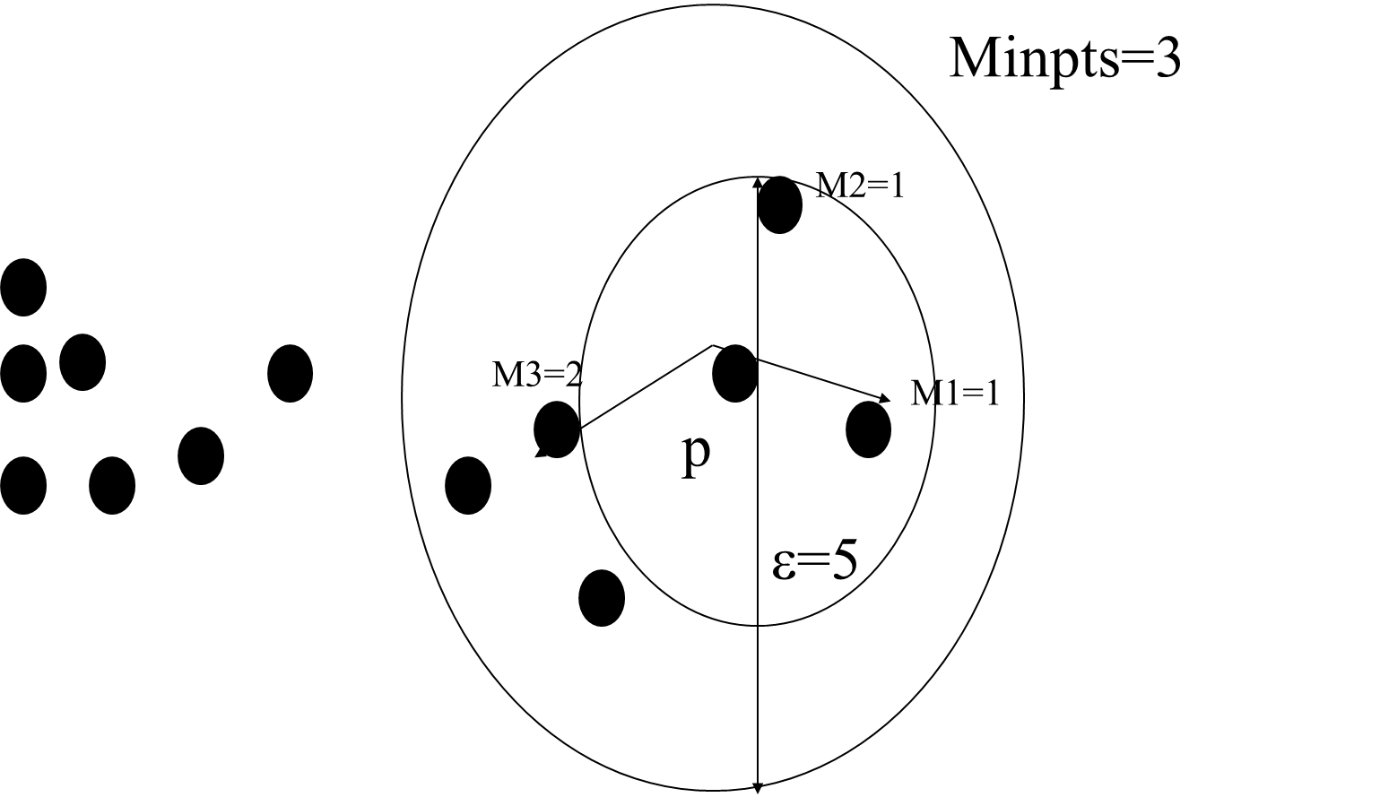
$$lrd\left(p\right)=\frac{1}{\text{average} \text{reachability} \text{distance} \text{of} \text{minpts} \text{Nearest} \text{neighbors} \text{of} \text{P}}$$
OPTICS-OF Example
$$lrd\left(p\right)=\frac{1}{\text{((1+1+2)/3)}}$$
=>1/(4/3)=3/4= 0.75
$$OF\left(p\right)=\frac{\frac{\sum{\left.lrd (o\right)}}{\left.lrd(p\right)}}{N}$$
$lrd\left(M1\right)=\frac{1}{\text{((1+1+2)/3)}}$=0.75
$lrd\left(M2\right)=\frac{1}{\text{((1+1+}\text{1}\text{)/3)}}$= 1
$lrd\left(M1\right)=\frac{1}{\text{((}\text{2}\text{+}\text{2}\text{+2)/3)}}$= 0.5
So the Outlier factor is:
(0.75+1+0.5/.75)/3=1
Data Analytics for Cybersecurity, ©2022 Janeja All rights reserved.

Slide 13
Distance-Based Outlier Detection
Distance based outlier detection algorithms continues the idea of a unified notion of mining outliers, which extends on the statistical based outlier detection
It generalizes the notion of outliers provided by many of the discordancy tests for known distributions, like Normal, Poisson, Binomial etc.
Although it proposes a partitioning based technique for distance based outlier detection, it also elaborates on how this approach can unify the various discordancy tests available in the statistical/distribution based outlier detection techniques
The time complexity is linear with respect to number of objects and the algorithms are efficient for low dimensional datasets
The key idea is that outliers are far away from their neighbors in terms of a distance threshold
Data Analytics for Cybersecurity, ©2022 Janeja All rights reserved.
Notes:
DB outlier initially proposed by Knorr ET. Al (2000)

Slide 14
Distance-Based Outlier Detection
The distance based outliers are identified with two parameters p, D namely DB (p, D)
An object O in a dataset T is a DB (p, D) outlier if at least a fraction p of the objects in T are at a greater distance D from O
Outliers are objects, which do not have enough neighbors within a certain distance
This eliminates the computation for fitting the observed distribution into a standard distribution and in selecting discordancy tests
For many discordancy tests for standard distributions if an object is shown to be an outlier then it is also a DB (p, d) outlier
Parameters p, D are set by a user in case of non-standard distributions, this is a trial and error approach, where the user interactively changes the p, D variables to evaluate the outcome.
This approach identifies outliers based on the distance of a candidate outlier from a set of neighboring points
it is not dependent on clustering structure of the dataset
The outliers detected however are dependent on user input
Most of these algorithms are sensitive to the user input like the distance threshold, or the value of p to identify the number of points for comparison to the candidate point
This approach is not suitable for high dimensional data as the Euclidean distance metric being used does not produce accurate results over high dimensions
Distance metric is a point metric, therefore it detects outliers which are at a distance greater than a parameter, and it does not take into consideration outliers which could be as a result of a very small distance measure
This technique is mainly geared towards detecting global outliers.
Data Analytics for Cybersecurity, ©2022 Janeja All rights reserved.
Notes:
(Ramaswamy et. al. 2000) eliminates the dependency in terms of the user input required for distance threshold. It also proposes outlier detection for large datasets using a pruning technique, this issue is addressed using structure like R Tree and CF Tree. This is a modified way of detecting outliers based on a distance threshold, it uses KNN query and detects global outliers. This technique provides a pruning technique to deal with large datasets. However, it does not handle multidimensional datasets and is unable to account for attributes contributing to outlierness.

Slide 15
Distance-Based Outlier Detection - Example
The distance based outliers are identified with two parameters p, D namely DB (p, D). An object O in a dataset T is a DB (p, D) outlier if at least a fraction p of the objects in T are at a greater distance D from O.
p=3
D=2
3.5
2.5
O
3
The fraction of points p is 3 and distance threshold is 2
The point O is at least greater than distance 2 from at least 3 points and can be labelled an outlier
Data Analytics for Cybersecurity, ©2022 Janeja All rights reserved.

Slide 16
Distance-Based Outlier Detection : Challenges
Distance based outlier detection methods suffer from the curse of dimensionality
In higher dimensions data becomes sparse, points tend to become equidistant
This adversely affects the methods based on spatial density, unless data follows certain simple distributions
For outlier detection a subset of the entire attribute set should be enough to detect or indicate the outliers
If we consider cross sections of the data in various dimensions we can find outliers
Data Analytics for Cybersecurity, ©2022 Janeja All rights reserved.

Slide 17
Outlier Detection through Clustering
Some clustering algorithms such as DBSCAN identify outliers as a byproduct of clustering
Majority of clustering algorithms have to be post processed to discover outliers
Outliers can be seen as a byproduct of the clustering process
In traditional clustering such as K-Means, by the end of the cluster analysis, we assign each data point to one of the clusters, so basically there are no unassigned data points
An example of clustering the SANS data for the last 1000 days records, targets and sources
This clustering was generated using Weka, Simple Kmeans
Since all the data is assigned to clusters, does that mean that there are no outliers in the data?
If there are still outliers, how do we filter out the outliers?
There are a few possibilities in a clustering output: (a) a point may be placed in a cluster by itself. (b) A data point may be part of a cluster but far from the centroid. (c) A small cluster with a lot fewer points than other clusters can be far from the other clusters. (d) In DBScan type clustering points will not be connected or in a cluster but a distinct outlier.
If a point is placed in its own cluster or is identified by the algorithm as an outlier such as in the case (a) and (d) then clearly a point anomaly has been detected. In the other two cases special analysis will need to be performed to identify anomalies
Data Analytics for Cybersecurity, ©2022 Janeja All rights reserved.
Notes:
http://isc.sans.edu/submissions_ascii.html
http://www.cs.waikato.ac.nz/ml/weka/

Slide 18
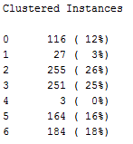
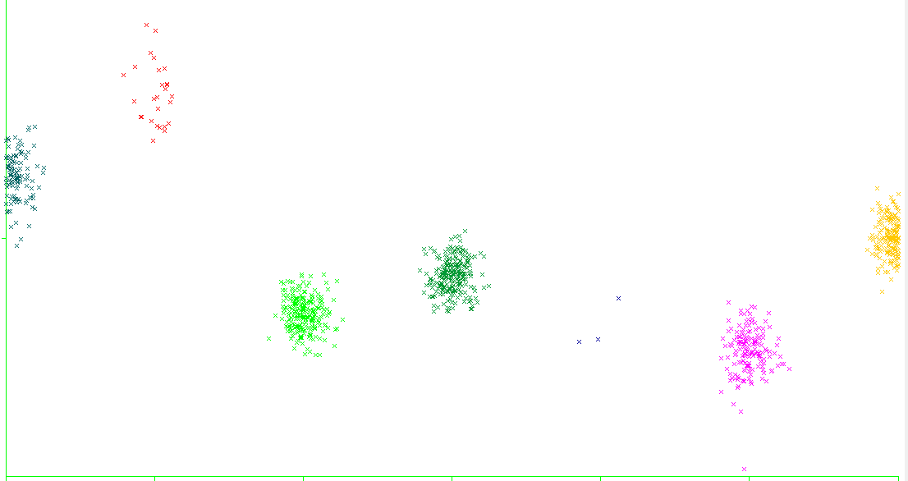
Outlier Detection through Clustering: Example
Cluster 2
1
2
3
4
5
6
7
Cluster 1
Cluster 7
Cluster 4
Cluster 3
Cluster 5
Cluster 6
Data Analytics for Cybersecurity, ©2022 Janeja All rights reserved.
Notes:
we can see a density distribution for each cluster and cluster 5 appears to have a very low density as compared to the other clusters. When we look at the three points in this cluster they represent a very high number of targets, sources and records indicating a high level of attack activity. Each of the observations has a date. If we further investigate the date by a simple Google search term for the time period and cyberattack, majority of the times we get news articles indicating the major attacks validating the unusual activity during the time period. This type of evaluation helps with exploratory analysis of the dataset.
. For example in figure 7.7, cluster 6 and 2 are potential clusters for post processing where the circled points could be identified as outliers.

Slide 19
Outlier Detection through Clustering: Example
Small clusters:
If the data is clustered into groups of different density and if there is a cluster with fewer points than the other clusters this cluster can be a candidate collective anomaly
In this case the density of the candidate cluster is highly deviant than the other clusters
There can be other measures such as the distance between candidate cluster and non-candidate cluster and if candidate cluster is far from all other non-candidate points, they are potential outliers
Larger clusters with scattered points:
There may be bigger clusters where the points in the cluster are not tightly bound around the centroid
In this case the distance of every point can be measured to the centroid and the points farthest from the centroid can be identified
This is similar to a distance based or a k-Nearest Neighbors based outlier detection inside such clusters
These clusters can be identified by looking at the Sum of Squared distance of the clusters and the ones with a high SSE can be candidates for post process through distance based outliers
Data Analytics for Cybersecurity, ©2022 Janeja All rights reserved.

Slide 20
References
V. Barnett and R. Lewis. Outliers in statistical data. John Wiley and Sons, 1994
Chandola, V., Banerjee, A., & Kumar, V. (2009). Anomaly detection: A survey. ACM computing surveys (CSUR), 41(3), 15.
Patcha, A., & Park, J. M. (2007). An overview of anomaly detection techniques: Existing solutions and latest technological trends. Computer networks, 51(12), 3448-3470.
Garcia-Teodoro, P., Diaz-Verdejo, J., Maciá-Fernández, G., & Vázquez, E. (2009). Anomaly-based network intrusion detection: Techniques, systems and challenges. computers & security, 28(1), 18-28.
Bhuyan, M. H., Bhattacharyya, D. K., & Kalita, J. K. (2014). Network anomaly detection: methods, systems and tools. Ieee communications surveys & tutorials, 16(1), 303-336.
Breunig, M. M., Kriegel, H. P., Ng, R. T., & Sander, J. (1999, September). Optics-of: Identifying local outliers. In European Conference on Principles of Data Mining and Knowledge Discovery (pp. 262-270). Springer Berlin Heidelberg.
Knorr, E. M., Ng, R. T., & Tucakov, V. (2000). Distance-based outliers: algorithms and applications. The VLDB Journal—The International Journal on Very Large Data Bases, 8(3-4), 237-253.
Sugiyama, M., & Borgwardt, K. (2013). Rapid distance-based outlier detection via sampling. In Advances in Neural Information Processing Systems (pp. 467-475).
Cao, L., Yang, D., Wang, Q., Yu, Y., Wang, J., & Rundensteiner, E. A. (2014, March). Scalable distance-based outlier detection over high-volume data streams. In Data Engineering (ICDE), 2014 IEEE 30th International Conference on (pp. 76-87). IEEE.
Zhang, K., Hutter, M., & Jin, H. (2009). A new local distance-based outlier detection approach for scattered real-world data. Advances in knowledge discovery and data mining, 813-822.
Ramaswamy, S., Rastogi, R., & Shim, K. (2000, May). Efficient algorithms for mining outliers from large data sets. In ACM Sigmod Record (Vol. 29, No. 2, pp. 427-438). ACM.
Aggarwal, C. C., & Yu, P. S. (2001, May). Outlier detection for high dimensional data. In ACM Sigmod Record (Vol. 30, No. 2, pp. 37-46). ACM.

Slide 21
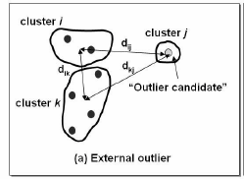
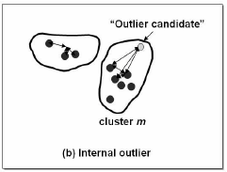
By the end of the cluster analysis, we assign each data point to one of the clusters, so basically we are not left with an unassigned data point. So that means there is no outliers in the data? How do we filter out the outliers? Will there be outliers? YES
Point may be placed in a cluster by itself
Point may be part of a cluster but far from centroid
DBScan type clustering - point will not be connected or in a cluster but a distinct outlier
Ref: http://ieeexplore.ieee.org/iel5/4343708/4343709/04343773.pdf?arnumber=4343773

Slide 22
Post-processing for outleirs
Post-processing
Small clusters may represent outliers
Split ‘loose’ clusters, i.e., clusters with relatively high SSE
Merge clusters that are ‘close’ and that have relatively low SSE
Can use these steps during the clustering process –keep track of SSE values

Slide 23
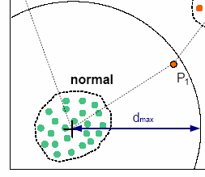
Example of Outlier Detection using Clustering
If the distance between an object and the centroid is larger than a predefined threshold d-max, the object is treated as an outlier
Ref: http://net.informatik.uni-tuebingen.de/fileadmin/RI/members/muenz/documents/muenz07k-means.pdf
Traffic Anomaly Detection Using K-Means
Clustering

